Slide 1
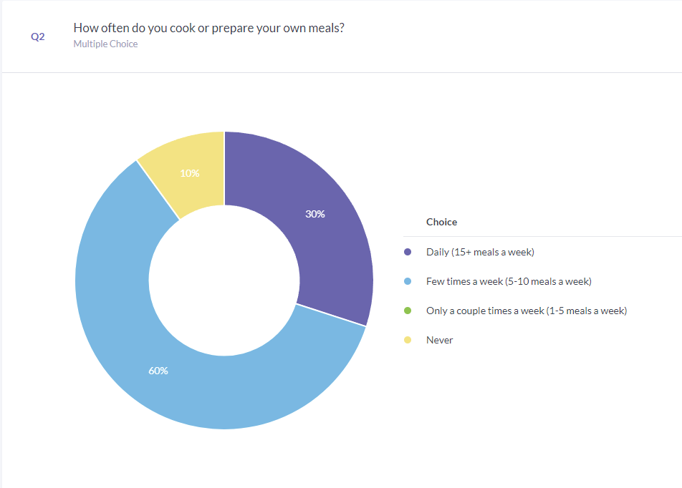
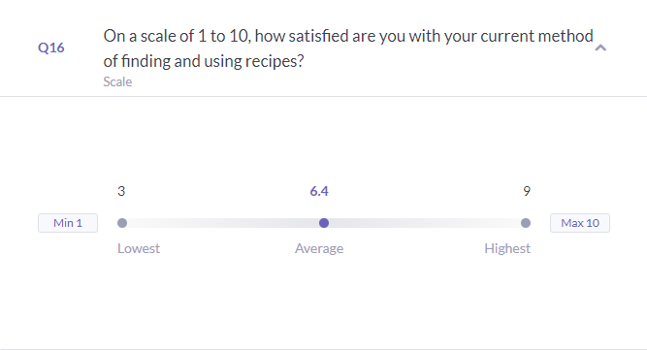
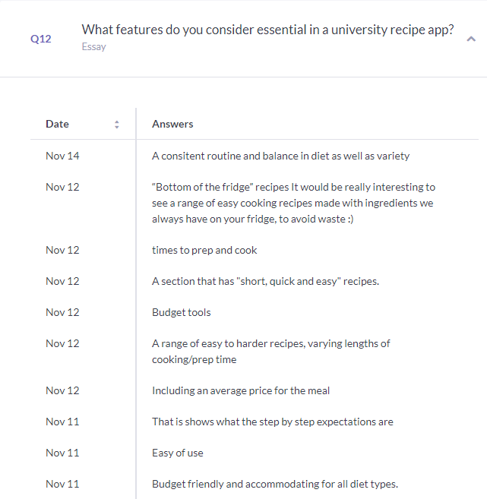
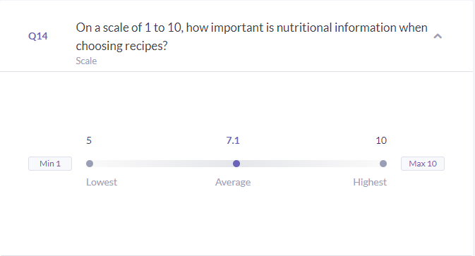
Housing Finder
Part Time Job Market
Section: User Research
Student ID Number: F128286
Initial Stage: The objective of the coursework is to develop an innovative app concept to be used by students. To meet this objective, I will be carrying out research and create designs with the data I obtain and strive to develop designs that are user centred. To initialise this task, I carried out a brainstorming session as a student in university to try and figure out what apps would be useful in my day-to-day life. From these apps I chose the recipe app, as finding recipes to cook are what I struggle with a lot. In addition to this, finding recipes that are quite cheap to make but are different from usual is quite a hurdle as a university student so I think that a recipe app would be a good concept,
Academic Resource Hub
App Ideas
Bargain Finder
Social Event Planner
Tutor Finder
Online Study Stream
Study Manager
User Research: My choice of user research was a survey. This data was collected by representative users from multiple universities ranging from first year to Post graduate students. I carried out user research to understand the problems and needs of the users revolving the concept of the recipe app I chose from my brainstorming stage. Gauging from the research I will determine the user’s current satisfaction and feelings with a recipe app . In the survey I carried this out by asking questions that would allow me to acquire both quantitative and qualitative results that can give me a descriptive overview of the current situation surrounding the idea. To carry out the survey I created a survey using SurveyPlanet so that I can determine the use of a recipe app for student.
Fig 2.
Fig 4.
Fig 1.
Fig 3.
Conclusions from User Research: Figures 1 – 4 are some of the highly valued questions from my survey. This survey displays that cooking is a crucial part of a university students' lifestyle where 60% of students that participated in the survey stated that they cook around 5-10 meals a week but to an extent 90% of students cook at some point during the week even if it isn’t frequent. In correlation with this students aren’t largely satisfied with their current method of finding and using recipes as there isn’t a collection of recipes readily available for them to search through, the satisfaction was measured on a scale with an average score of 6.4 from my sample of my target market.
Furthermore, I wanted to develop an image of the app through the perspective of students like myself so in the survey I asked for opinions on potential features they would see benefit I gained various insights, largely budgeting and well-structured easy to follow recipes was requested to be a part of the recipe but the other opinions will also be considered in the developmental stages. Nutritional information is also deemed important when choosing recipes this could be added in a meal planner of some form. To figure out how to compete with other recipe apps that could have been developed I also gathered opinions on improvements or additional features that could be added to existing recipe apps.
One participant of the survey answered by stating that having more visual assistance would be useful as written instructions can sometimes be misleading and unclear. Another student answering the survey also expressed their wish to see more variety in terms of cuisine and this is relatable as being a student looking for recipes on social media you tend to see the same concept repeated and can be quite mundane when you are trying to find something new and exciting. I also found out that in general student feel that they have a lack of time to cook meals throughout the week, so implementing a feature that would enable them to figure out how long it would take to cook a meal could solve this. Another issue that students have stated is that they find the shopping process to procure the ingredients quite tedious.

Slide 2
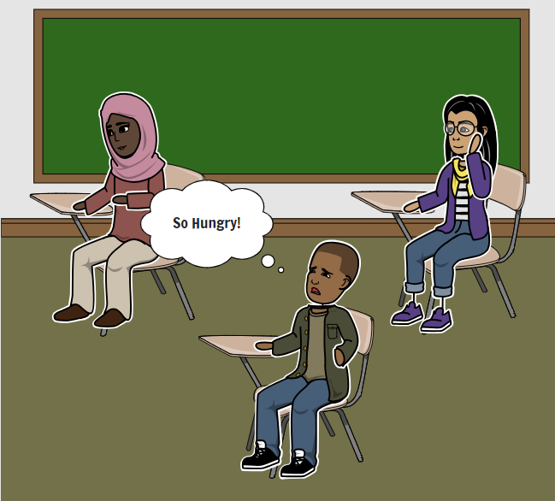
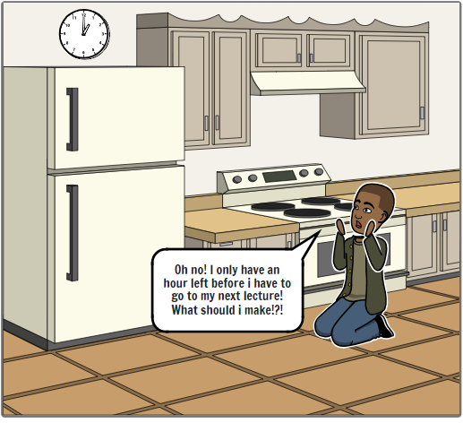
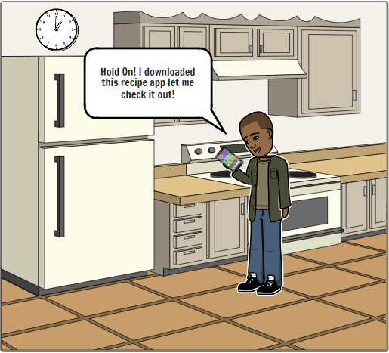
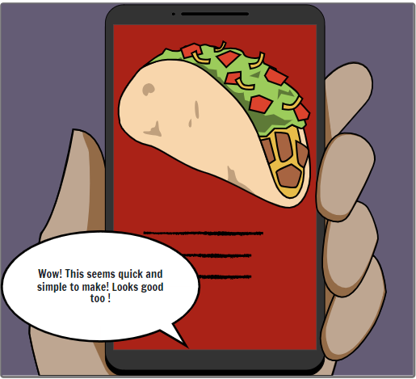
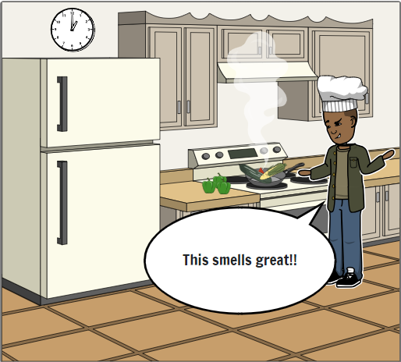
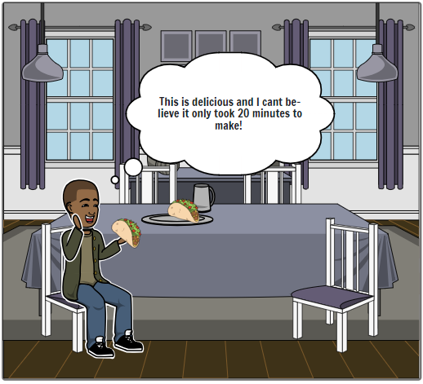
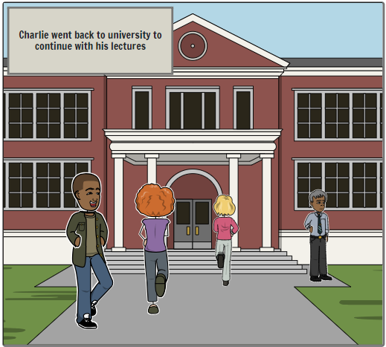
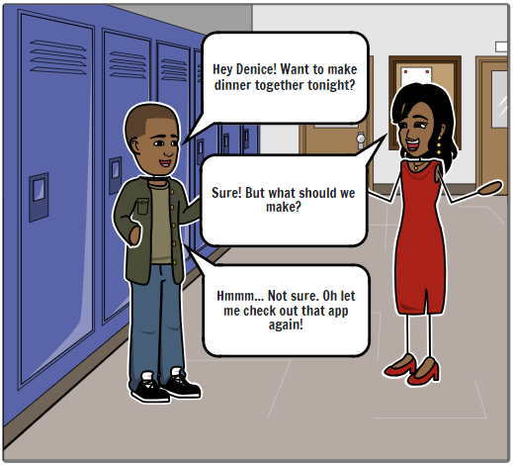
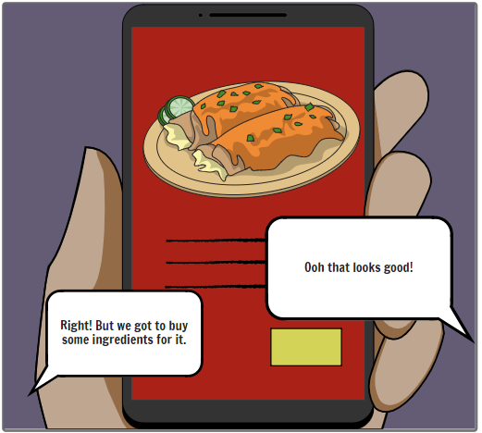
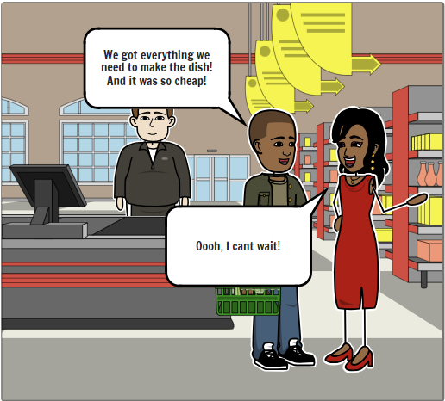
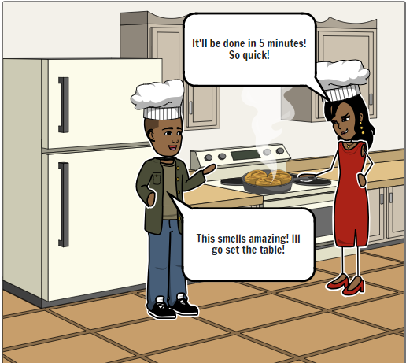
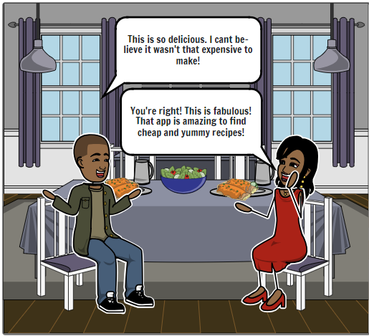
Section: Concept Storyboard
Scenario: A student is trying to figure out what to cook quickly in between his lectures and organize a dinner with his friend later in the day.
User Persona: A Loughborough University student that cooks 3 to 4 meals a day
User Needs: The student wants to find and cook meals that fit his dietary requirements, cooking time and explore new meals to try out
This student is sitting in a lecture and has gotten hungry
After getting home he realizes he has little time before going to his next lecture.
He realizes he downloaded the ‘UniRecipeApp’ and checks the app
He finds a quick, easy and tasty looking recipe he can cook right away.
After the students finds the recipe, he begins using it to cook
The student is happy and content with the food and how quick it took to cook
The student heads back to schools with the full stomach ready to focus in school
After his lecture he meets with his friend, and they decide to cook dinner together.
The student shows his app to his friend, and they find a recipe they would like to cook
The student and his friend go to the store to buy the needed ingredients and are surprised by how cheap it is
After getting home, the students begin cooking following the recipe
After setting their plates, they begin enjoying their conversation over the cheap hearty meal they had made.

Slide 3
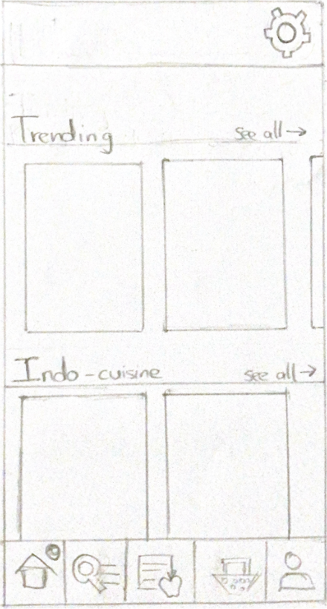
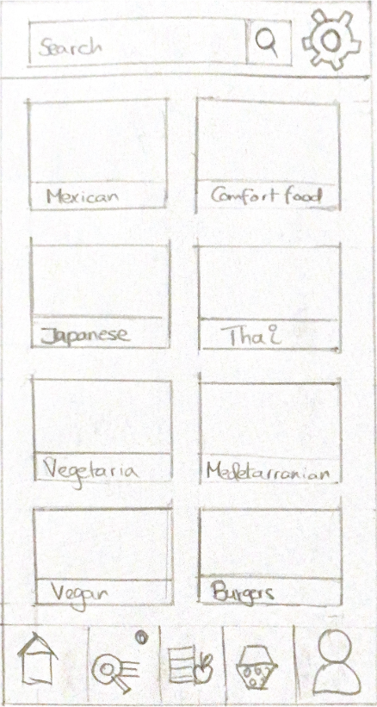
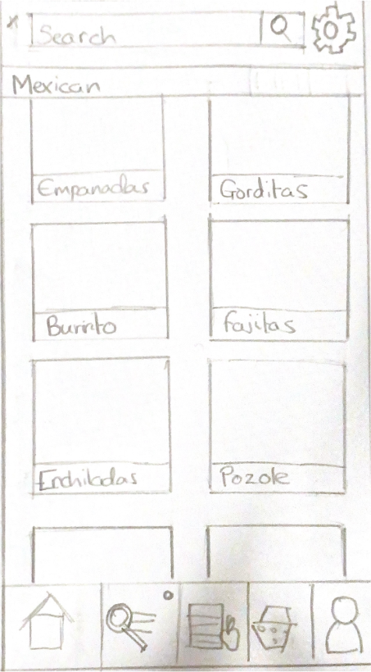
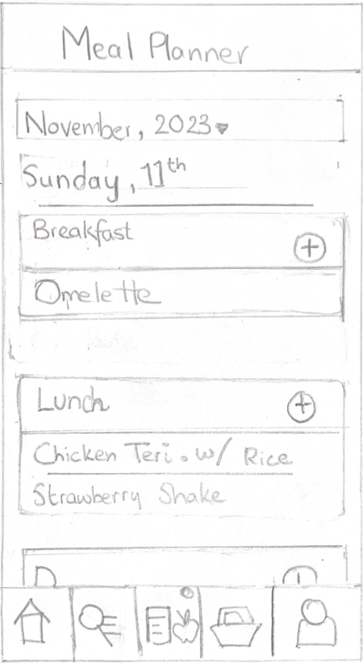
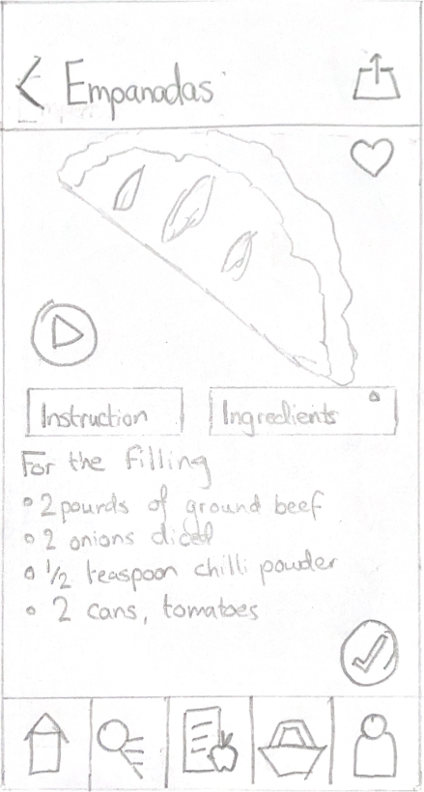
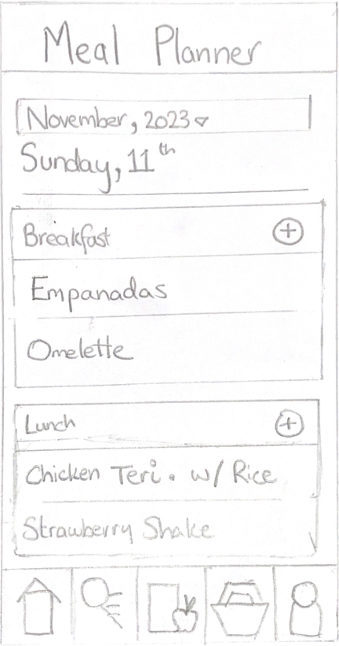
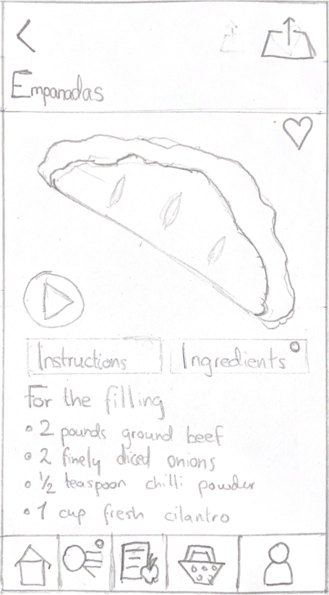
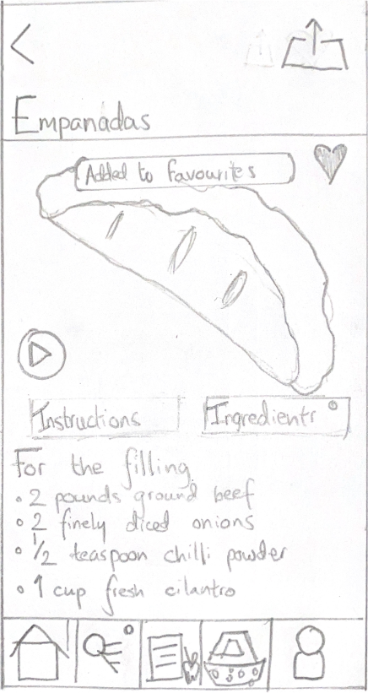
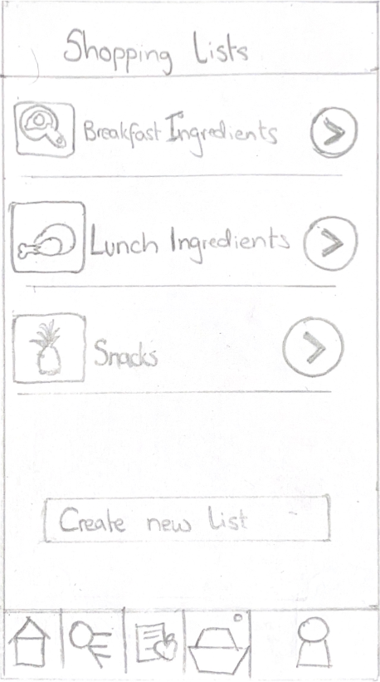
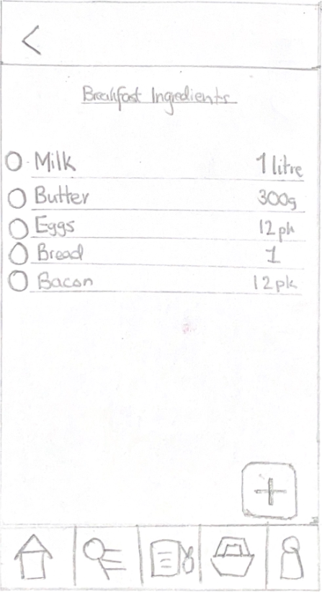
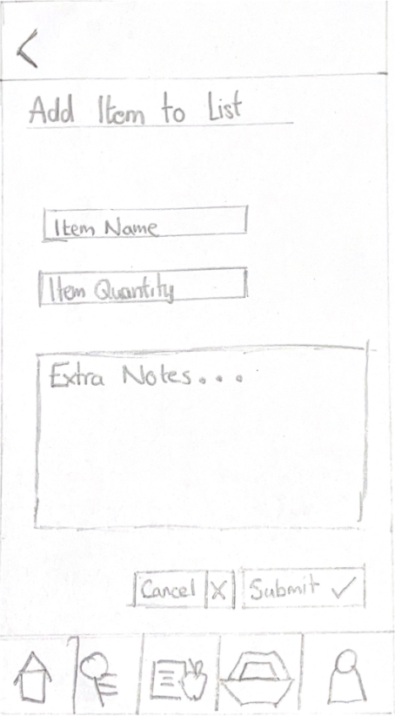
Section: Version 1 – Low Fidelity Protoyping and Testing
Task 1: Find the Empanadas Recipe and Add to Favourites
Task 2: Add the Empanadas Recipe to your breakfast in the Meal Planner
Home Screen
Search Screen
Search Screen – Mexican Cuisine
Home Screen
Meal Planner Screen
Search Screen
Search Screen – Mexican Cuisine
Meal Planner Screen
Empanadas Recipe Screen
Empanadas Recipe Screen
Favorited Recipe Screen
Feedback During Task 2: Participants liked the button that directed them to the Meal Planner Screen from the Home Screen. Both students were pleased with the Meal Planner Screen stating how clear and useful the meal planner seemed. They liked the fact that they could track their meals in a manner. They enjoyed the simplicity of searching for a meal and adding it to their meal planner using the search screen from before. One thing they mentioned was how the favoriting feature is still available in this process and stated that it seemed too cluttered for this task. They also mentioned they liked being able to view a video guide on the recipes. They also suggested changing the meal planner icon to a book.
Feedback During Task 1: Participants of the test for this prototype were University Students – One was a second-year student, and the other student was a third-year student. The first thing mentioned by both students was the fact that the overall layout of the home screen was nice and seemed quite sleek. They mentioned it could be useful if there were buttons put in place so that you could scroll horizontally so it is easier to navigate. They stated there was no apparent logo for the app and one of them suggested to use a simple text logo. They liked the layout of the search screen stating it was clear and easy to understand how to use. They also declared that the use of buttons and information layout on the recipe app was well thought out. A participant stated that the size of the buttons were proper, so it was clear to see what does what. Participants also thought that the notification that appears after favoriting the recipe was a good idea, so people know when they have successfully confirmed that its favorited. They communicated that it would be good to also be able to search on the search screen and lead to the Empanadas recipe so that there isn’t just one way of looking for a recipe.
Task 3: Add item to Breakfast Ingredients in Shopping List
Home Screen
Shopping List Screen
Add to List Screen
Breakfast Ingredients List Screen
Feedback During Task 3: Participants were content with a shopping list feature being included within the app. They liked how they could generate separate lists allowing them to be more organized when it came to shopping. One participant stated that this could even help in budgeting. On adding to the List screen, a participant suggested adding a unit text field for more accurate entries.

Slide 4
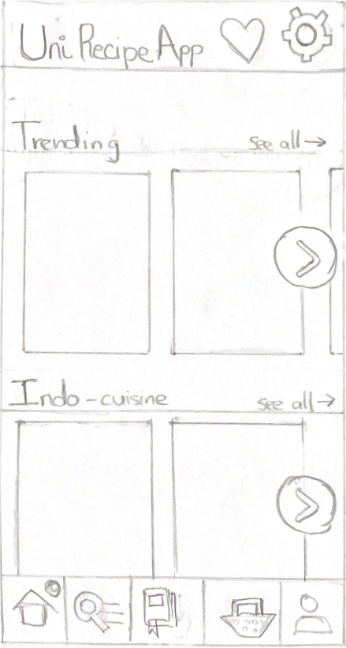
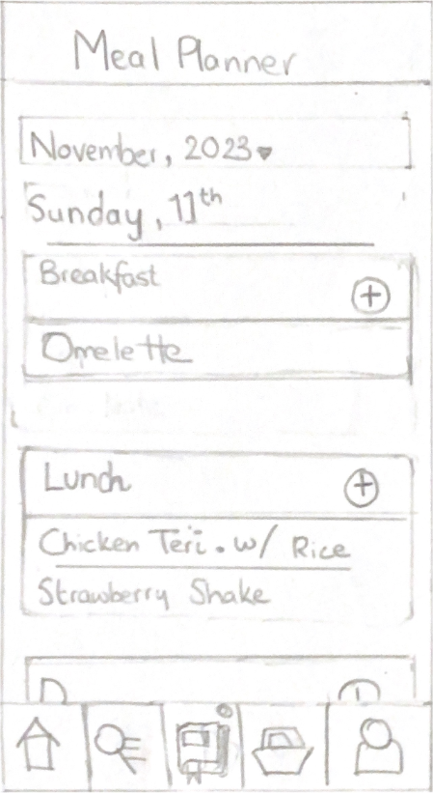
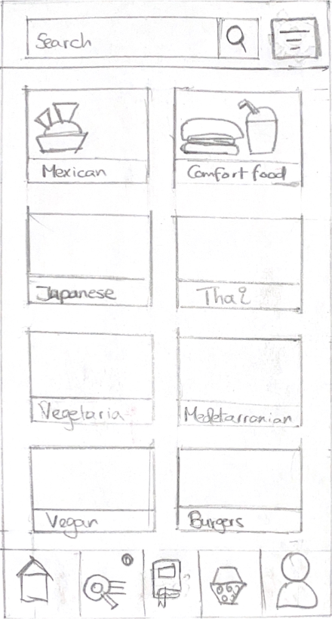
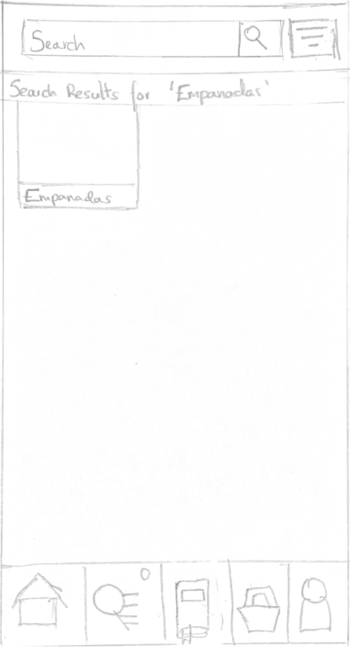
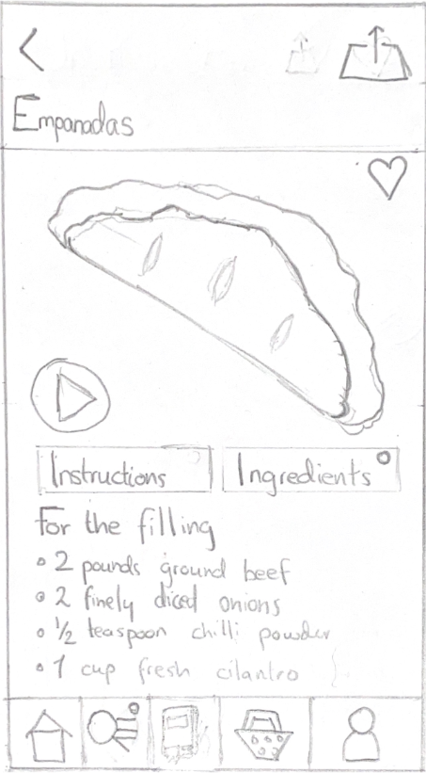
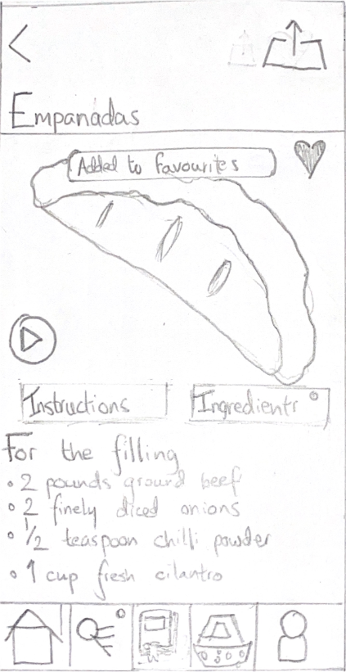
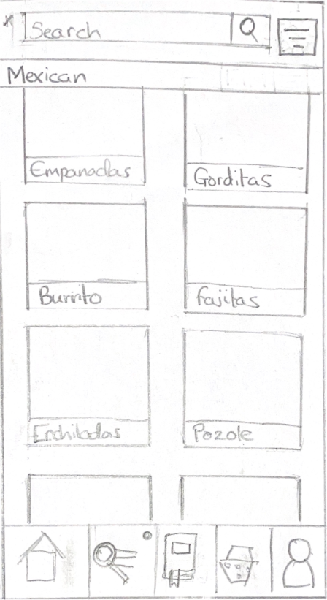
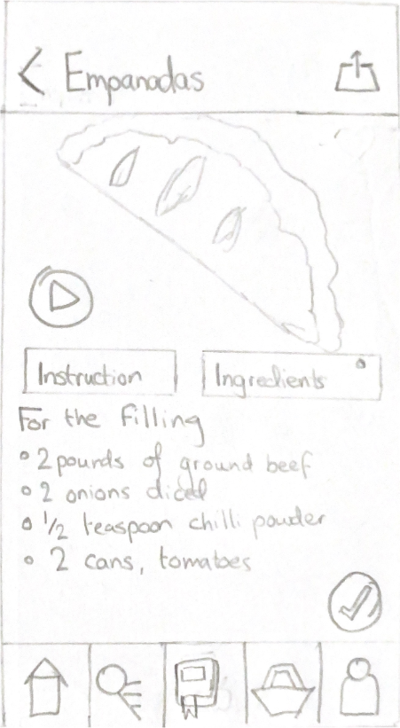
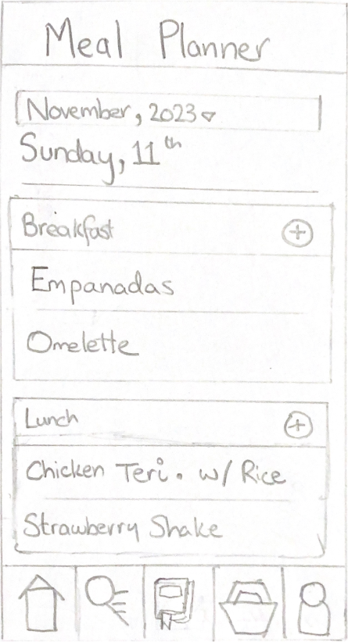
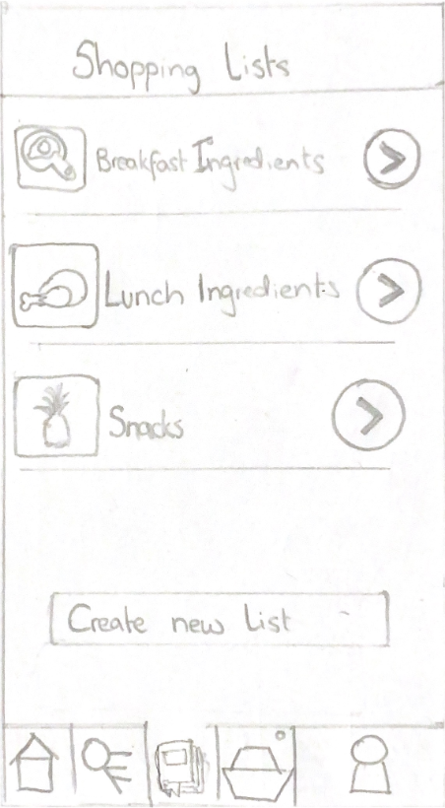
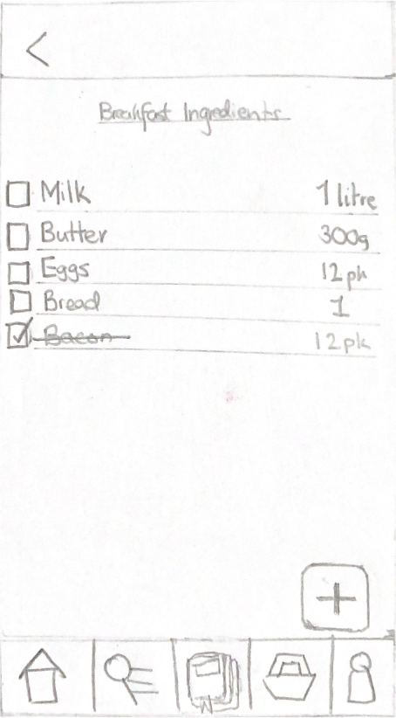
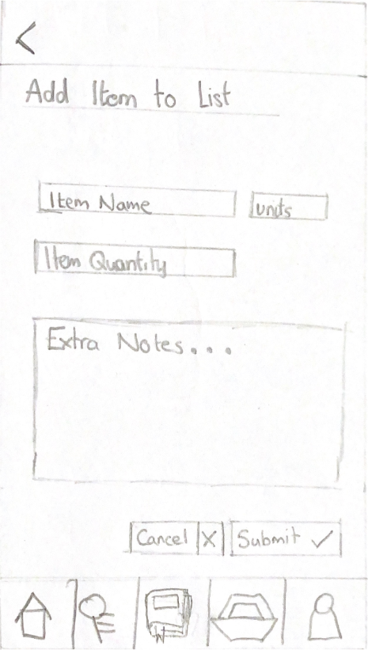
Section: Version 2 – Low Fidelity Prototyping and Testing
Task 1: Find the Empanadas Recipe and Add to Favourites
Task 2: Add the Empanadas your breakfast in the Meal Planner
Home Screen
Searched Screen - Empanadas
Home Screen
Meal Planner Screen
Search Screen
Empanadas Recipe Screen
Search Screen
Favourited Screen
Search Screen – Mexican Cuisine
Empanadas Recipe Screen
Meal Planner Screen
Search Screen – Mexican Cuisine
Feedback During Task 2: Participants realized that the arrows had been added to the home screen and stated that though its clear they preferred being able to see the overview clearly instead. They stated that the recipe of the meal that was to be added (Recipe Screen) was a lot nicer to look at after the removal of the favorite icon. When observing the process of completing the task by both participants it seemed quick and no mistakes were made overall.
Feedback During Task 1: Participants expressed their like for the change of icon for the meal planner shown on the Home screen. They also stated they liked the Logo and its location along with the addition to the favorite icon on the home page. They believe the navigation now after displaying the search capability makes sense and the navigational flow of the prototype was intuitive.
They also suggested further that a screen to see the favorite screen and displaying the options on each recipe would be a good addition. Furthermore, they stated that they would like to see the filter option in use.
Task 3: Add item to Breakfast Ingredients in Shopping List
Home Screen
Shopping List Screen
Add to List Screen
Feedback During Task 3: The Students found no problem with completing this task as it was straightforward. Once again both students stated how they are pleased with the layout of the Shopping list and Individual list Screen. They are also content with the change of the round checkboxes to square checkboxes stating that it looks more cohesive with the screen layout. They were satisfied with the additional ‘Unit’ Input field.
Overall, they stated that they understood how to navigate through the screen layouts for all tasks without any guidance and found that the App would be quite helpful with meal planning as a busy university student.
Breakfast Ingredients List Screen

Slide 5
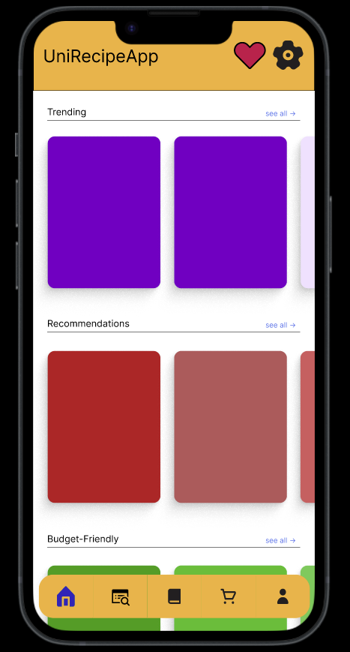
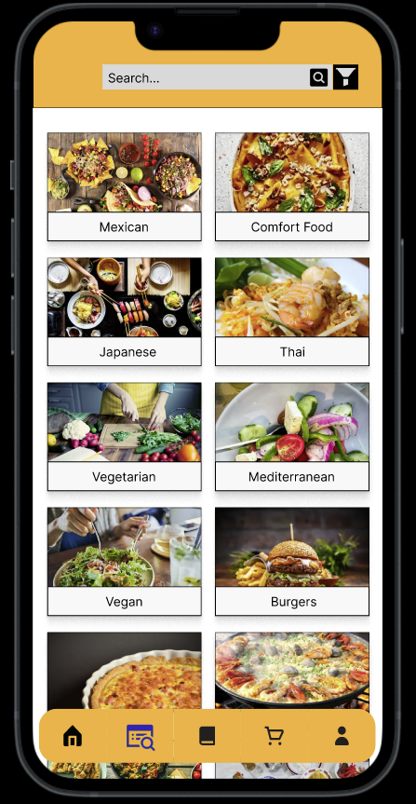
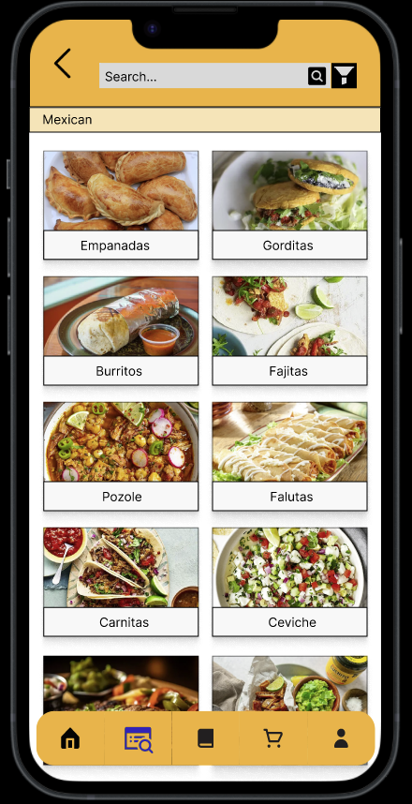
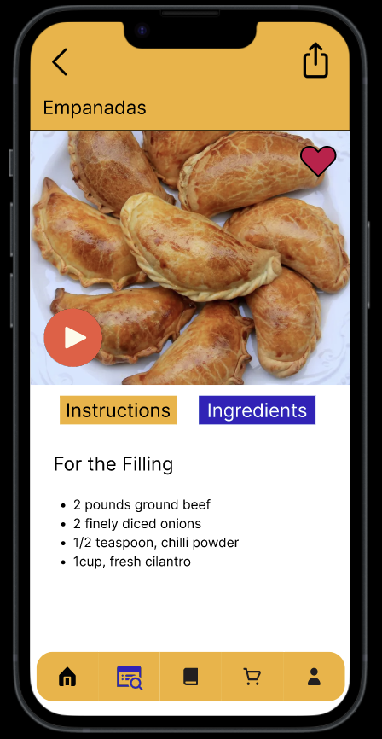
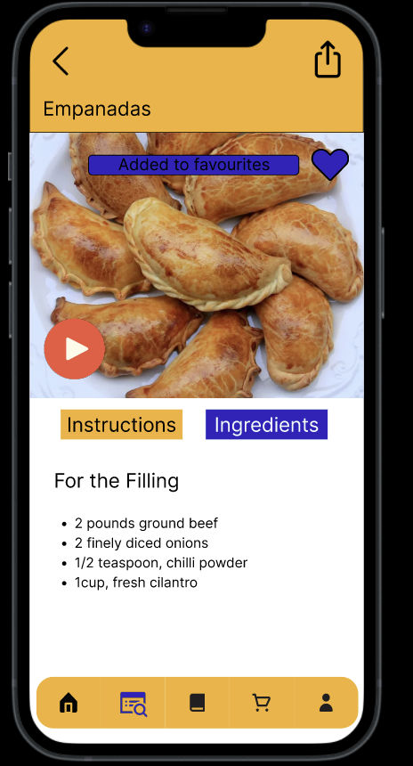
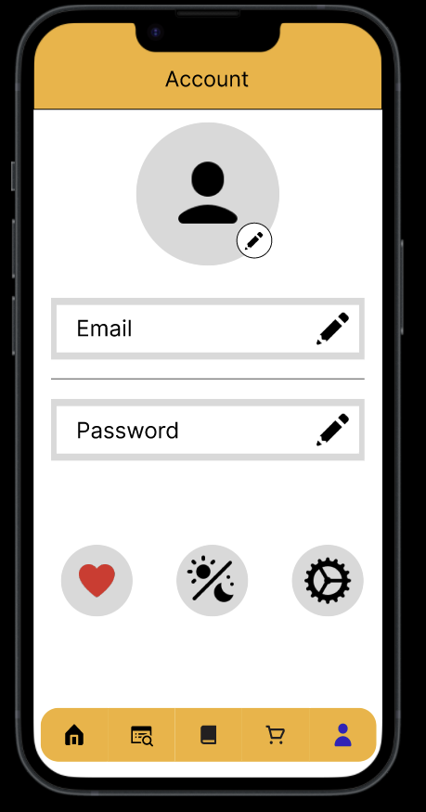
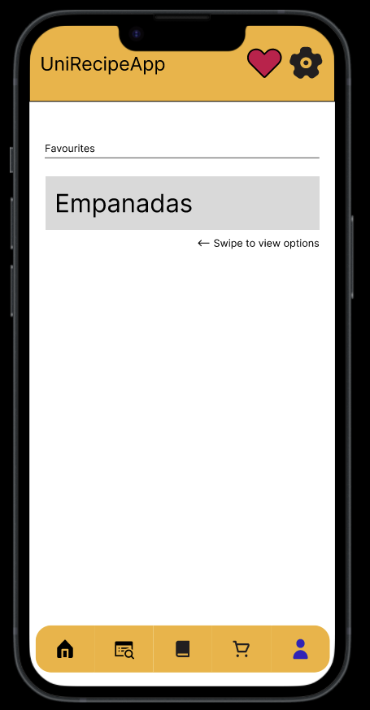
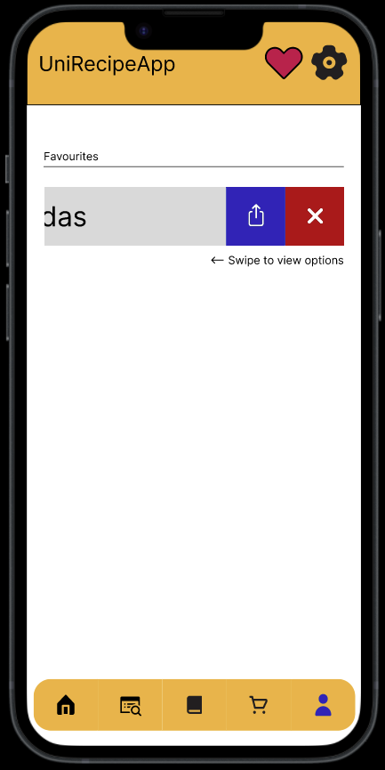
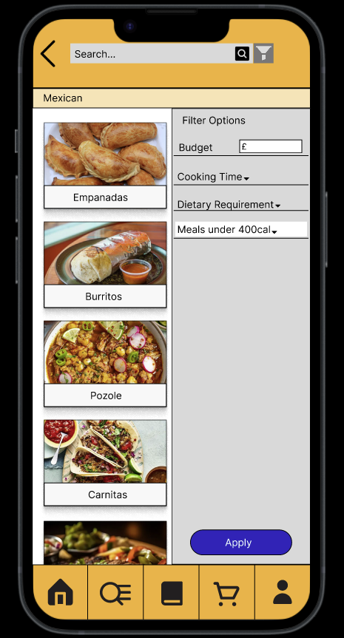
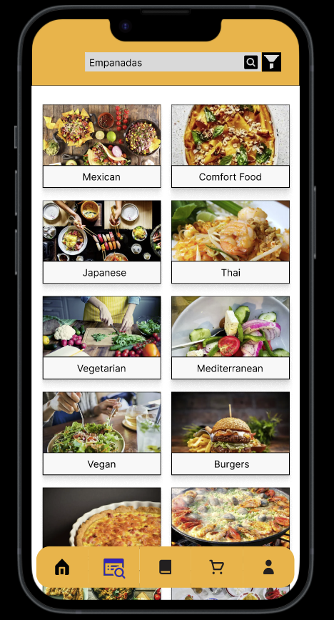
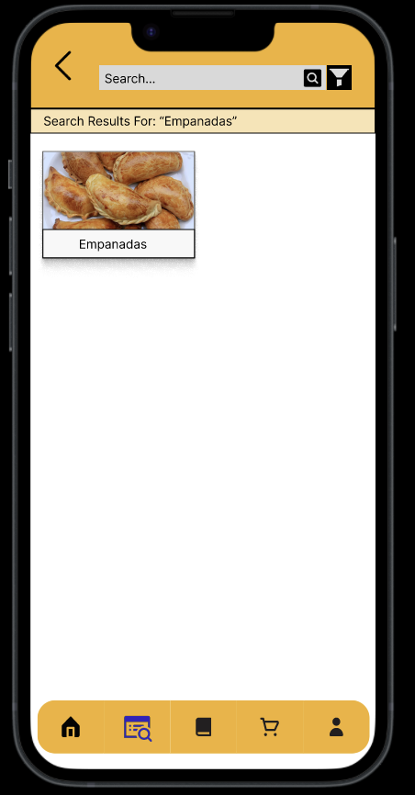

Task 1: Find the Empanadas Recipe and Add to Favourites
Section: Software Prototype Development
Empanadas Recipe Screen + Favorited
User’s List of Favorites Screen
Home Screen
Main Search Screen
Search Screen - Mexican
User Account Screen
The home screen is the first screen. I had modified the Bar so that it seemed more modern. Though the students in the prototyping stage liked the bar they said it could look a little more updated rather than traditional. The sections on the home screen are horizontally scrollable to view the recipes of that filter. The boards would be clickable leading to the individual recipes. To view sections, you can scroll vertically.
To navigate to find a recipe you would click the search button on the Bar of the home screen leading to the cuisines section and there are different methods of navigating to a specific recipe. One way could be through the info cards with clear bright images so users can identify through visual cues. Or there is a method of directly searching through the search bar. I added a filter option during the development of the software prototype to display the greater capabilities the user would have when finding recipes on the App. As shown on the filter screen there are various ways to filter recipes with factors such as: budget, cooking time, calorie requirement etc. This increases the searching power of the app allowing users to quickly and efficiently discover newer recipes.
Once arriving to the recipe page, you would be able to play the video directing how to cook the recipes which can be played by the big play button on the left corner of the thumbnail. In addition to this the user could select the whether to view the ingredients or the instruction. The user's selection of tabs gets indicated through a colour change where the text becomes a white and the tab turns blue.
On the recipe page, when the user clicks on the favourite option there is a notification that pops up to tell the user it has been added to their favourites list. There is also a colour change on the favourite icon to show that the user has clicked on it where it goes from red to blue back to red after a short delay.
After adding an item to the favourite list, the user can now navigate to the user’s list after going into the accounts page where the user can change their email and password. On the User accounts page there is a button leading to the Favourites page. At the favourites page you can slide each recipe card to open options where you can share the recipe with friends, or you can remove the recipe from the list. The action of finding the users favourite list will not be included in the testing of task 1 but will be queried to receive end user comments and thoughts behind this feature.
Filter Option on Search Screen
Search Screen – Empanadas Entered
Search Screen – Search Result
Connected Screens

Slide 6








Section: Software Prototype Development
Task 2: Add the Empanadas your breakfast in the Meal Planner
Empanadas Recipe Screen
Meal Planner Screen - Updated
Home Screen
Meal Planner Screen
Search Screen
Search Screen – Mexican
The User will click on the meal planner icon, and it will get highlighted and direct them to the Meal Planner Screen. The user will be able to see the month and year and with the day. Under this the user will see three sections for Breakfast, Lunch and Dinner. Each section will have a calorie counter where it will take a meals calorie count and add it to a total to each section. The user can add a meal by clicking on the add button at each section which will direct them to the catalogue of cuisines in the Search Page where they can find specific meals that they have made. On the Recipe screen, there won't be any favouriting option only selection options. Upon selecting a meal, the user will then return to the Meal Planner Screen with an Updated calorie count and list in the section that the meal was added to.
Task 3: Add item to Breakfast Ingredients in Shopping List
Breakfast Ingredients List Screen
Add to List Screen - Filled
Breakfast Ingredients List Screen - Updated
Home Screen
Shopping List Screen
Add to List Screen
The User will click on the Shopping basket icon on the bar, and it will direct them to the Shopping List Screen. Here there are 3 ready-made lists for ingredients each with different colours and buttons that allow the user to open the individual lists. There is also an option on this screen to create more lists to fill the user’s account. Upon opening a list, the user will be able to view a checklist where they can add items or check them off. To add an item the user will be able to click the add button and it will lead them to a screen where they can write in text fields and add additional notes before submitting the item into the list. After clicking submit they will return to the list with updated contents. When the user checks an item, it will strike through the name of the item and check the box.

Slide 7
Section: User Testing, discussion and reflections on the process
Aim of Study:
The aim of the study is to evaluate the ease in which my target population can employ the application which was developed with design principles, to carry out specific tasks. I will be carrying out an assessment in use of the Software prototype that I developed as I have already carried out assessment by inspection with the Paper prototype and had received feedback for it. After carrying out the assessment through a test I will be able to evaluate the prototype that I had made against the Usability Performance framework covering the following : Learnability, Efficiency, Satisfaction and Memorability
Participant Sample Description: To conduct testing on my software prototype I have recruited 4 students from different universities
Method of Testing the Software prototype:
The 4 participant that were utilized for this test had read the information sheet and signed the consent form to carry out the test.
Testing was confirmed to be carried out online on Microsoft Teams to ensure that all students could participate in testing.
The participants were given 3 tasks on the software prototype to carry out via screen share. Participants would direct the instructor to carry out the tasks.
To gain an insight into the designs’ quality I carried out data collection by recording the time taken to complete each task to calculate the average task time, a single ease question to determine the ease of use and the number of errors completing each task to find the error rate.
Results
Task 3 took the longest time on average to complete by the students, this can be validated as on the creation of an item in a list the user will have to input the name, unit and quantity of the item and submit the item onto the list At task 1 when observing I realised that the participants chose the incorrect button
Task 1 contained the greatest number of errors during testing. This makes sense as it was the participants first time seeing the system and as a result navigating the software for the first-time people are likely to experience missteps. This is supported by how on the third task no participant made an error when carrying it out.
From the Single Ease Question, we can determine that the tasks where in fact easy to use overall due to all participants rating every task over 5. With this we can evaluate that the students found the first task slightly more difficult yet were generally content with the ease of use of the application.
Feedback and Findings:
Task 1- Overall, the users found that this task was clear and intuitive, it was easy to navigate through the application on the software prototype. The content of the page was easy to read and digest, one user stated that the contents of the pages were placed effectively with colours that weren’t too harsh on the eyes allowing there to be a moderate balance and that this carried out with the other tasks too. Another user mention that the favouriting feature with the colour change delay was a great add to the page and was visually appealing. After testing, I showed the participants the additional filter screen and favourties list via the accounts page to gain some feedback on the overall cohesiveness of the application. The participants liked the swiping feature that opens more options, they also expressed how the account page could have some more organizational features implemented such as having the favourite list, dark mode and settings buttons in one container to be less cluttered. After looking at the Filter screen that was added a user stated that the filtering options were well thought out but also stated that adding a few more options such as ‘spice level’ could make the option to discover new meals more exciting.
Task 2 and 3- The participants stated after testing that the flow between the screens in these two tasks were seamless and had a clear way of leading to the completion of the tasks. They were satisfied with the simplicity of navigating through the task and locating recipes in the search screen when completing both tasks. One participant stated that looking at the search page was really engaging due to the images placed as thumbnails being vibrant and colourful. The participant stated that when looking for a new recipe to cook they would look for meals that stand outs to them, so this is great. All the participants mentioned that the calorie counter was a perfect idea as some of them stated that they are keeping track of the calories to follow a certain diet to add to this the users stated that in the individual recipe screens it would be a good idea to add calories somewhere so that users can decide before cooking or adding it to the planner. They also suggested that adding a notification after the user had added an item to the list will let the user keep track of what they added to a degree.

